Slide 1

DATA WRANGLING AND EXPLORATORY DATA ANALYSIS ANIME DATASET
Dhrishya Sureshbabu Menon

Slide 2
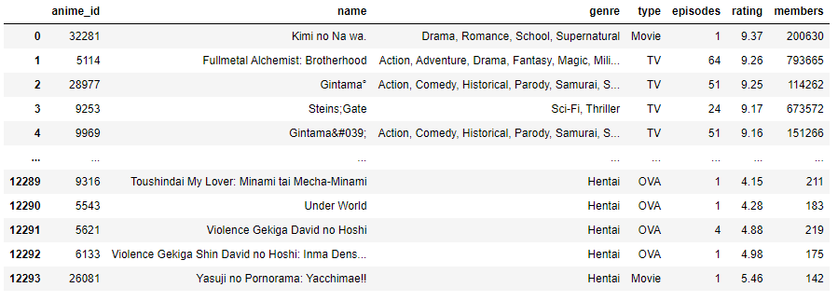
ANIME DATASET
The Dataset has mainly 12294 rows and 7 columns

Slide 3
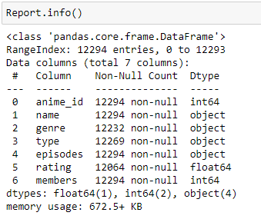
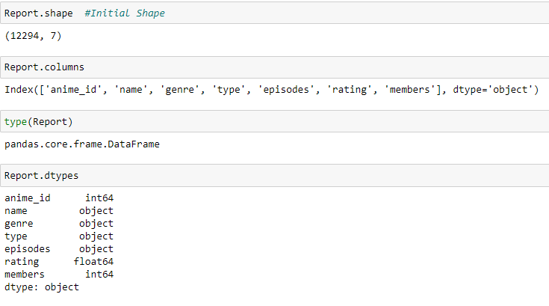
Preparation of the Dataset
The Dataset is initially prepared by viewing the info which showcases the column names and the column types.
The shape of the dataset is found out along with the type of the dataset.
The column names present within the dataset are displayed.
The types of each column are also displayed.

Slide 4
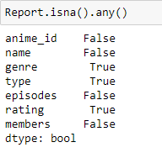
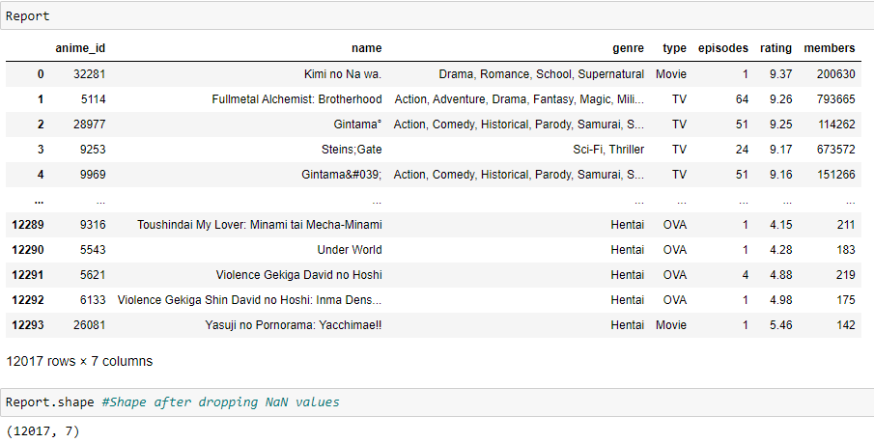
Cleaning of the Dataset
The Dataset is first checked to see if the columns have any Null Values present within them.
The values are checked and then dropped from the columns
The shape of the Dataset changes after dropping the null values.

Slide 5
Exploratory Analysis & Visualization
Data analysis is performed on the Dataset along with data visualization where depending on the data different graphs are plotted.
Mainly Six different types of exploratory analysis are performed on the dataset.
Functions such as groupby, selecting columns, sorting the column for obtaining specific data, filtering the columns based on values, detecting and extracting outliers,.
Histograms, Pie plot, Bar Chart, Boxplot, Line Graph are all utilized to showcase the visualization of data.

Slide 6
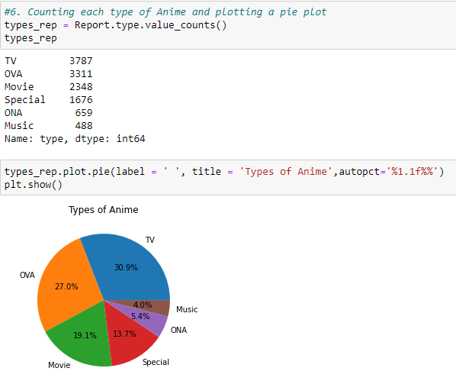
Example Analysis performed in the Dataset
Different types of Anime are first categorized with the help of values_count
A new data frame is created from the chosen dataset to help with analysis and visualization.
A Pie plot is plotted which showcases the percentages of different types of Anime’s present in the dataset.

Slide 7
Asking & Answering Questions about the Dataset
In this section, mainly four questions have been asked about the dataset, the answers are obtained by analyzing the dataset in depth.
The questions are as follows:
Which are the top 10 highest rated anime’s which have been watched by atleast 20,000 members?
The most high-rated anime’s belong to which type and their percentages?
Which Studio produces most number of the anime from Manga source?
Comparison of Total number of people who watch, Total number of people scored and total number of people who favorited the anime’s

Slide 8
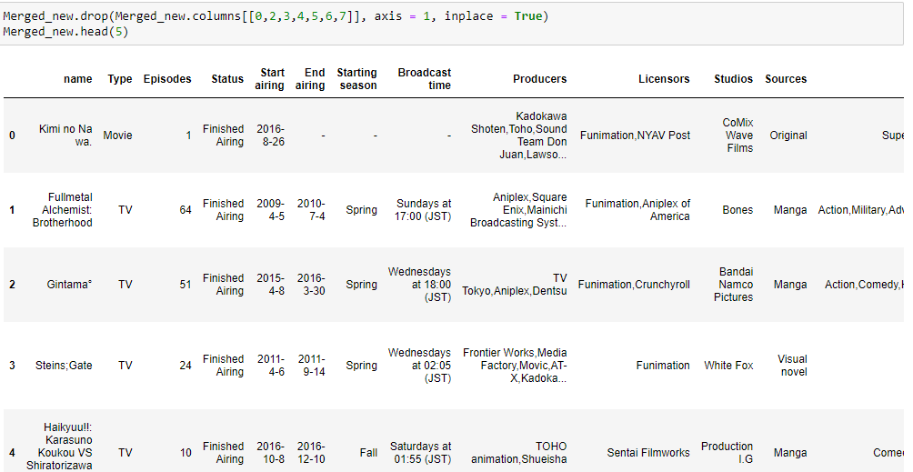
Merging a New Dataset
A new dataset is merged with the existing dataset and the common columns are dropped from the newly merged dataset.
The new dataset contains additional information which is beneficial to the existing dataset. It consists columns such as studio, producers, duration, status of the anime etc.

Slide 9
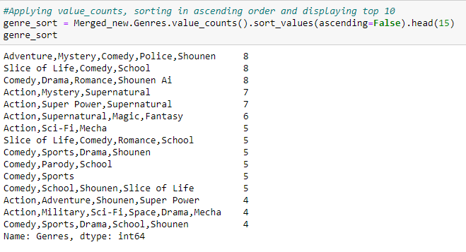
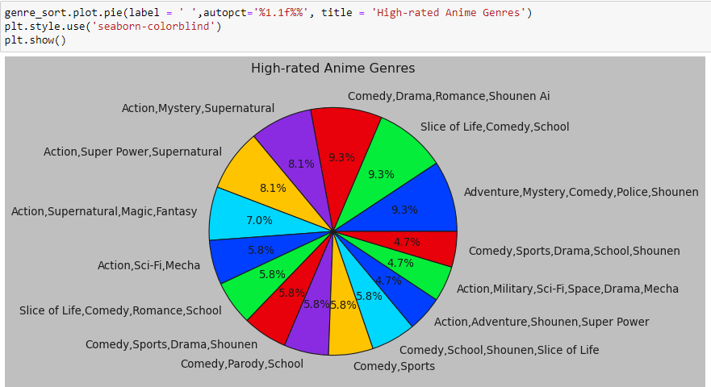
Question asked about the Merged Dataset
The different types of genre of Anime are found out here.
They are displayed by sorting and counting in the ascending order.
The percentages of the various genres are then displayed using pie plot.

Slide 10
Conclusion
Three main steps are performed on the chosen dataset of Anime:
Preparing and Cleaning
Exploratory Analysis and Data Visualization
Asking and Answering Questions
Different plots are made use of such as Histograms, bar plots, box plots along with line graph and pie plots that help in visualizing
the data in the dataset to obtain answers to specific questions and to obtain information regarding the dataset in general

